Slide 1
Ukraine and Russia crisis
Network impact
assessment
NMD/ACD/OPL/DES
19 JAN 2022

Slide 2
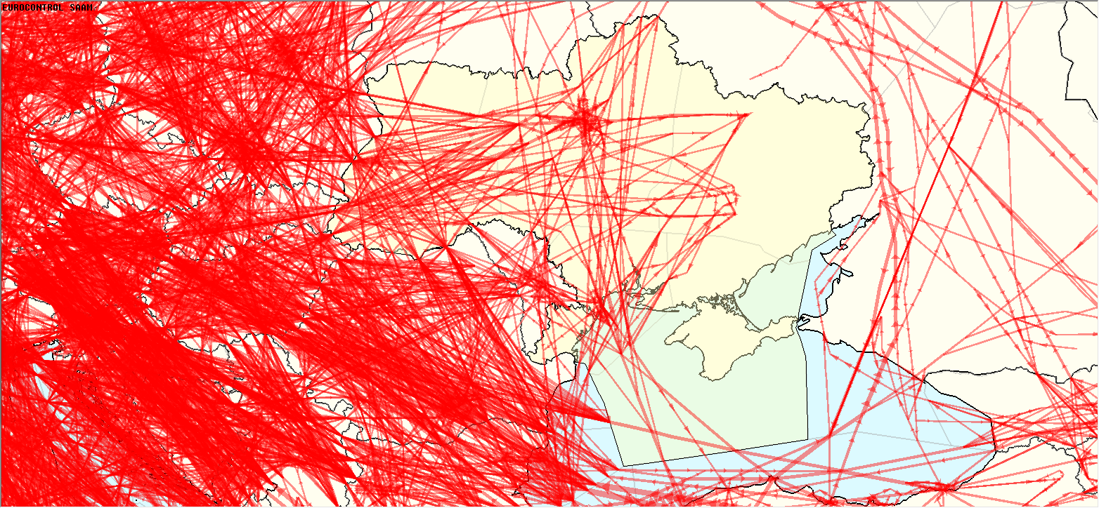
Current situation
All traffic (FPL)
09 JAN 2022

Slide 3
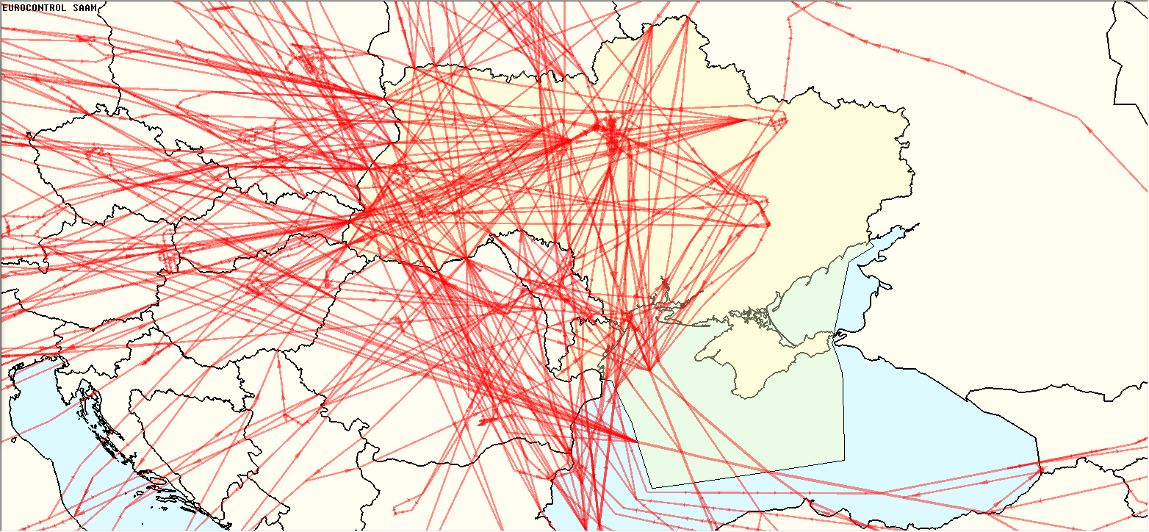
Current situation
Flights crossing UKR (Traffic assigned on the shortest route)
09 JAN 2022
827 flights in total

Slide 4
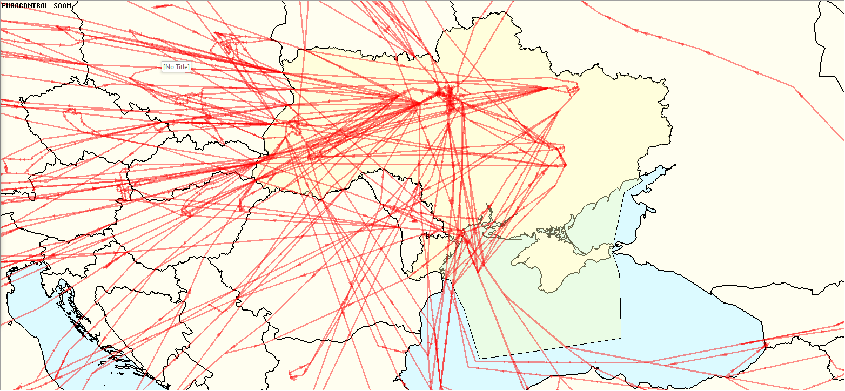
Current situation
ARR/DEP to/from UKR (Traffic assigned on the shortest route)
09 JAN 2022
473 flights
with ARR/DEP
to/from UKR

Slide 5
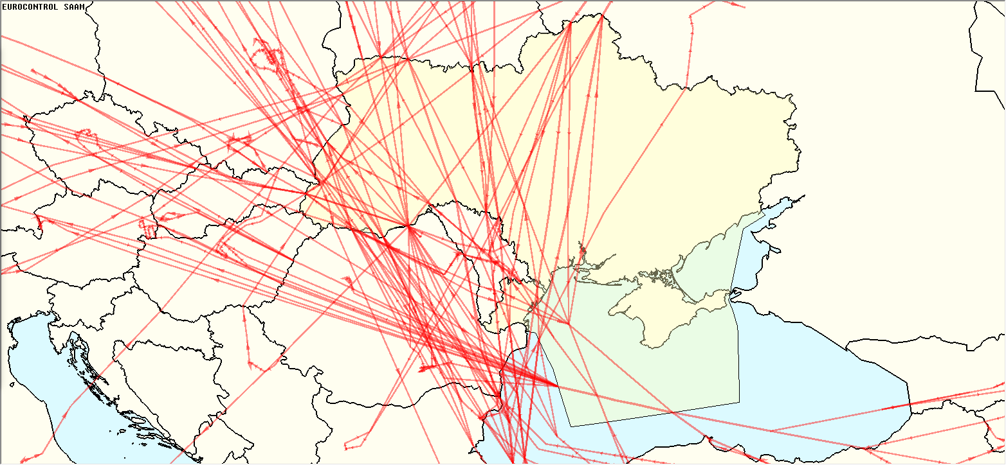
Current situation
Overflights (Traffic assigned on the shortest route)
09 JAN 2022
354 overflights

Slide 6
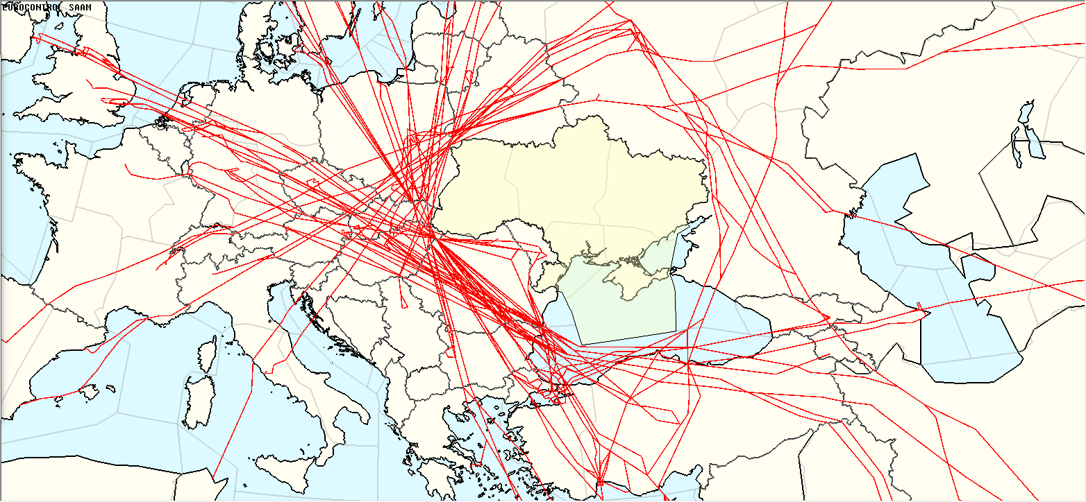
Current situation
Rerouted flights (Traffic assigned on the shortest route)
09 JAN 2022
354 overflights

Slide 7
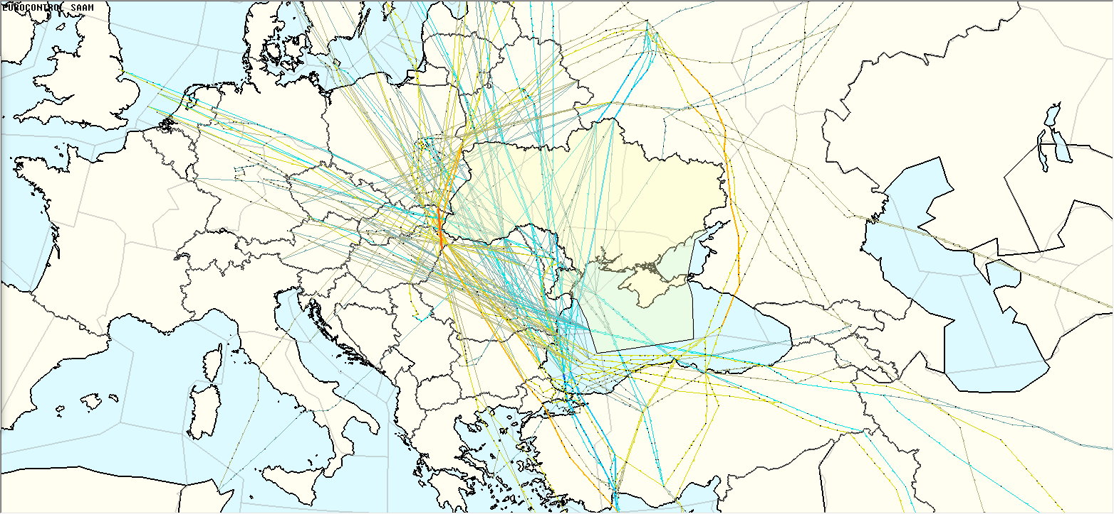
Current situation
Comparison
09 JAN 2022
Scenario Economy (Potential gains/losses)
Total impacted flights | Length (NM) | Time (min) | Fuel (kg) | CO2 (kg) | NOx (kg)
354 | 26326 | 3515 | 158777 | 498549 | 2109

Slide 8
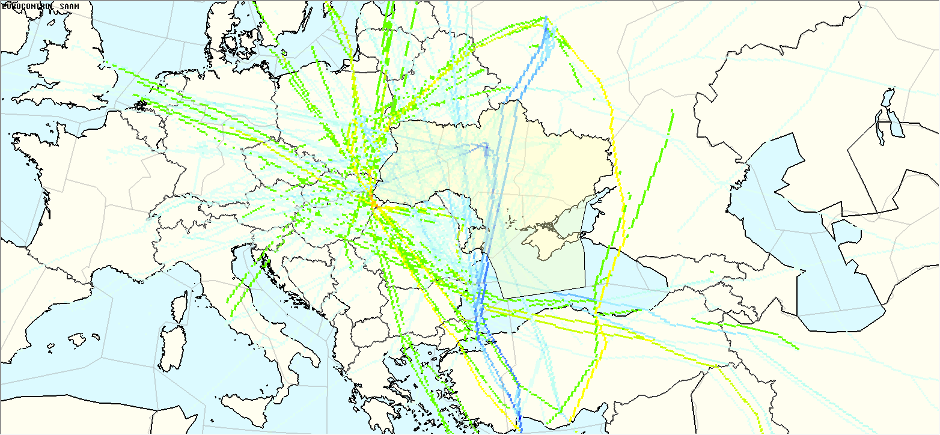
Current situation
Comparison
09 JAN 2022

